Slide 1
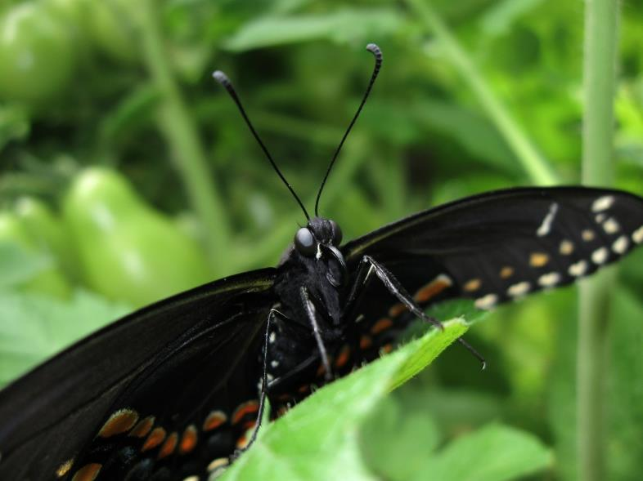
Black swallowtail
From Egg to Shutterbug

Slide 2
A bit of biology
Butterflies start as eggs that hatch into caterpillars.
Caterpillars have exoskeletons (“skins”) that can only stretch so far, so they must be shed.
Each time it sheds, a caterpillar starts a new part of its life cycle called an INSTAR.
After 5 instars, a Black Swallowtail, Papilio polyxenes, will become a chrysalis from which the adult will emerge.
Egg, Caterpillar (5 instars), Chrysalis, Adult.

Slide 3
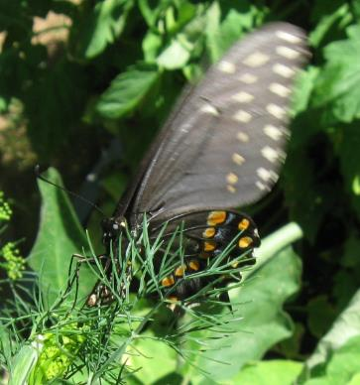
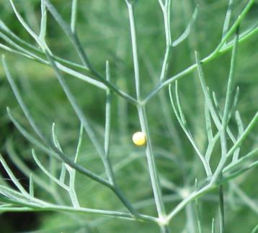
We begin with an egg …
Or with an adult female laying an egg on a dill plant in the garden.

Slide 4
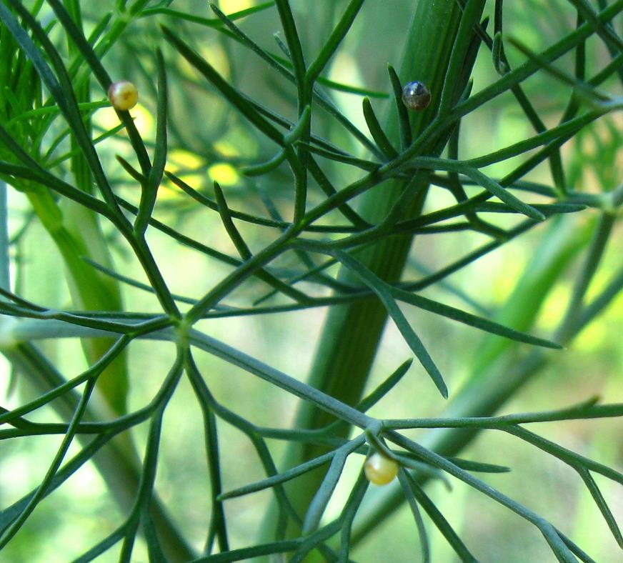
Development in the egg
Eggs take 3 days to develop.
Freshly laid egg above.
Three developing eggs to the right.

Slide 5
First instar
After a successful hatching, what is the first order of business?
Eating?
Or cleaning up?

Slide 6
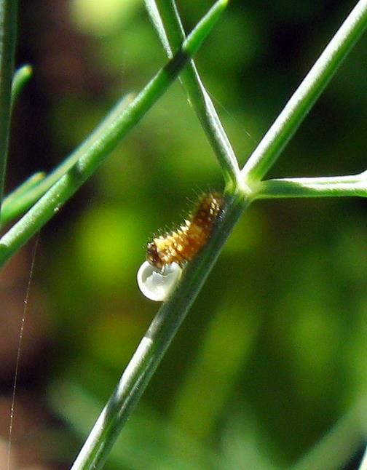
Perhaps both.

Slide 7
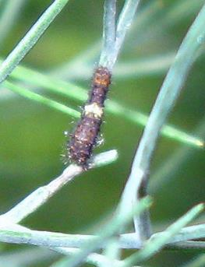
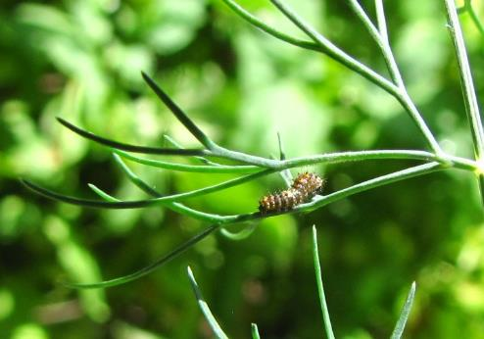
First Instar
The first and second instars look like bird droppings, or like they are wearing saddles. The caterpillars are much more cryptic at this stage than they are later. They are highly variable in colour but not pattern.

Slide 9
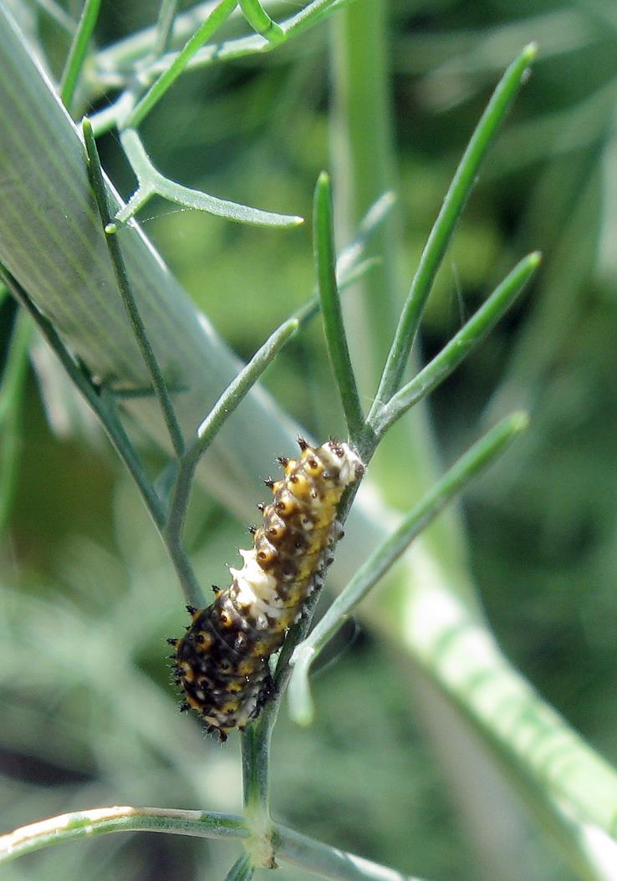
Second instar
The appearance of this instar is quite similar to the first, but some orange dots along the sides and at the base of the spiny bumps (chalazae) have become more prominent.

Slide 10
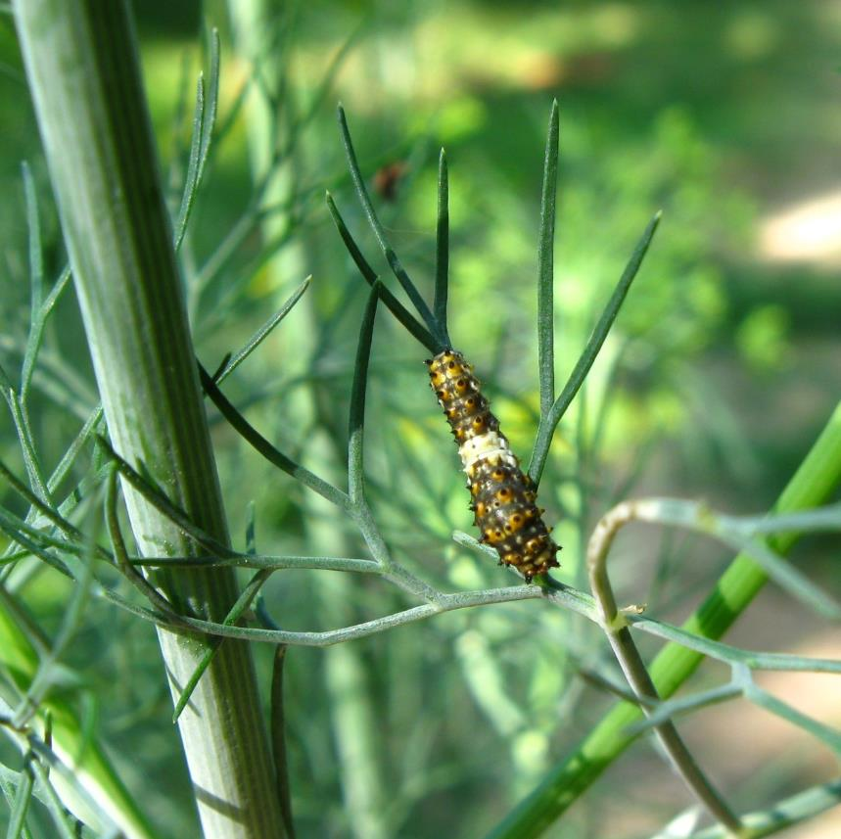
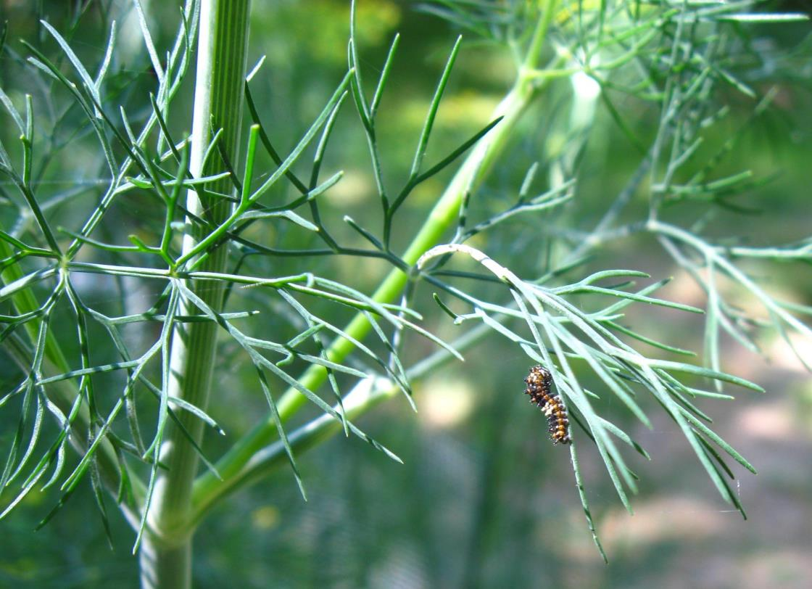

Slide 11
Not all will make it.
Approximately 1 in 100 caterpillars that hatch will emerge as an adult.
This one has fallen prey to a spider.
From the 20 or so eggs that I was able to find, only one caterpillar became an adult.

Slide 12
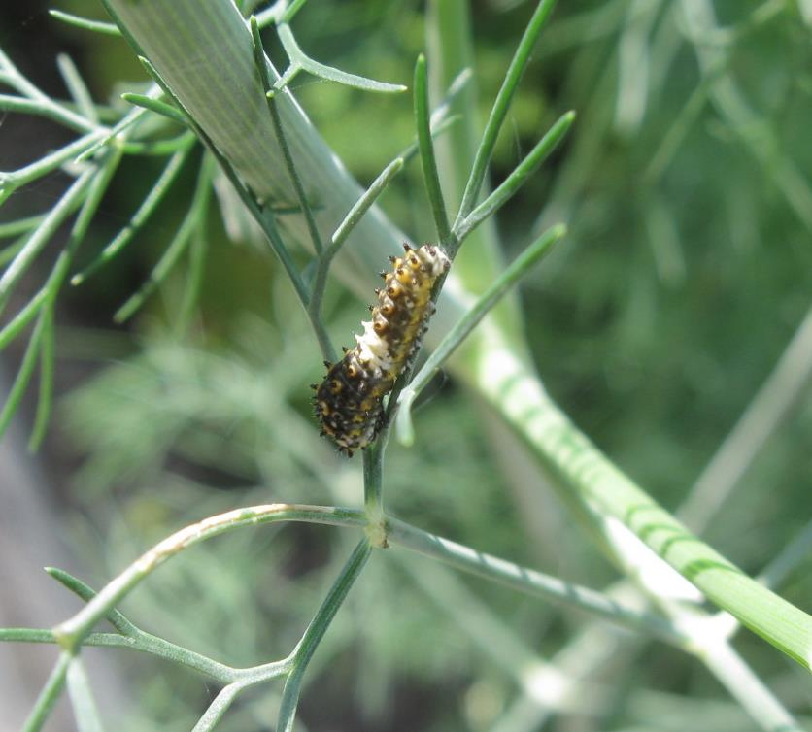
What to eat?
During the first and second instars, most of the caterpillar’s nourishment comes from scraping the epidermis of stems and leaves.
Towards the end of the second instar, the caterpillar is able to nip the tender tips of growing leaves.

Slide 13
Third instar
The saddle is retained in this instar but overall the caterpillar is more conspicuous. It is starting to gain some of the striping that will be more evident in the last two instars.
That wizened, black blob above the caterpillar is the just-shed skin of the second instar.

Slide 14
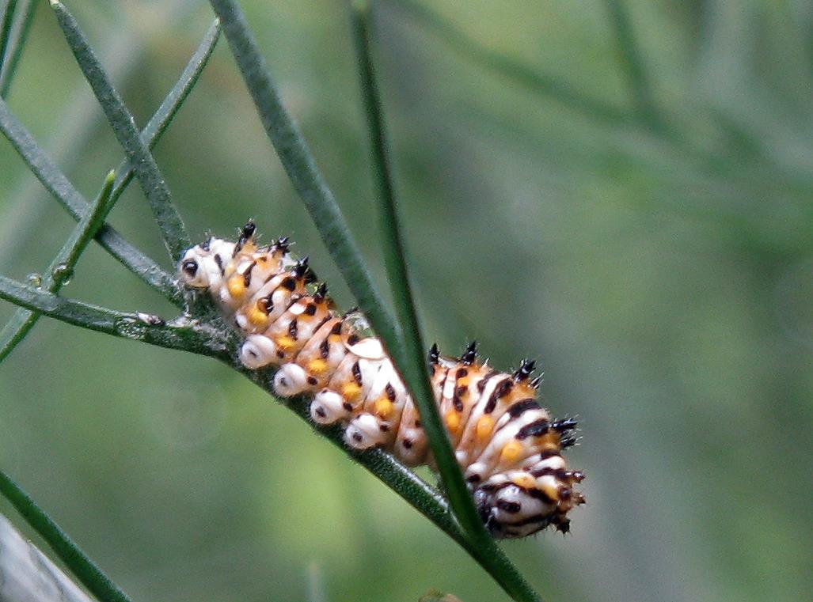
Anal Prolegs
Chalazae with setae (sensitive to touch)
Abdominal Prolegs
Head

Slide 15
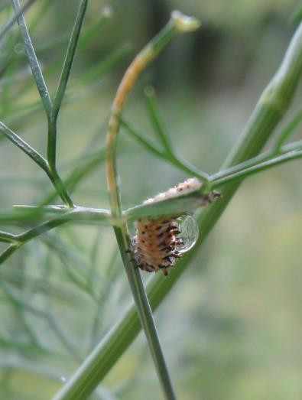
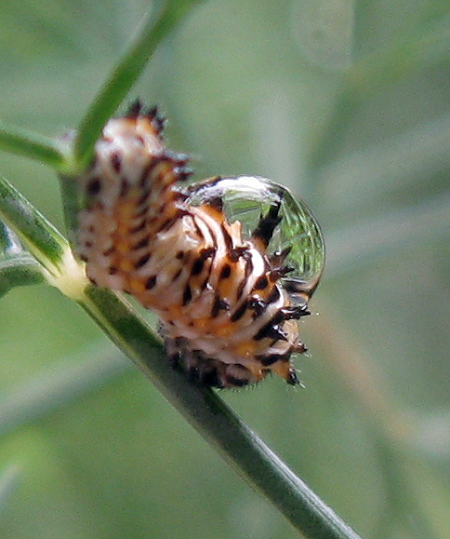
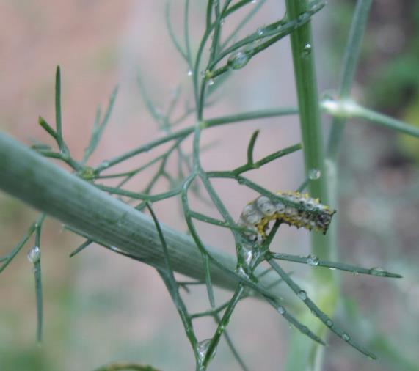
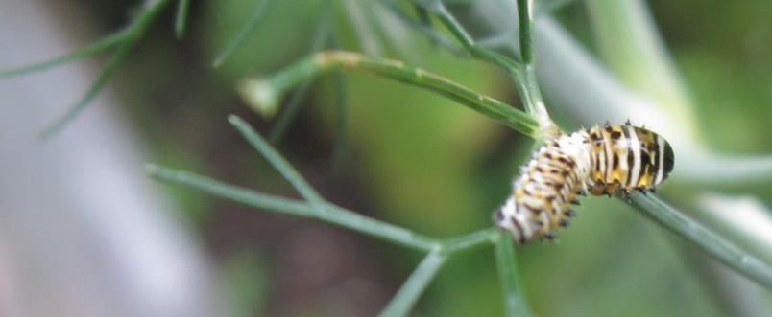
And when it rains?
Just ignore it.

Slide 16
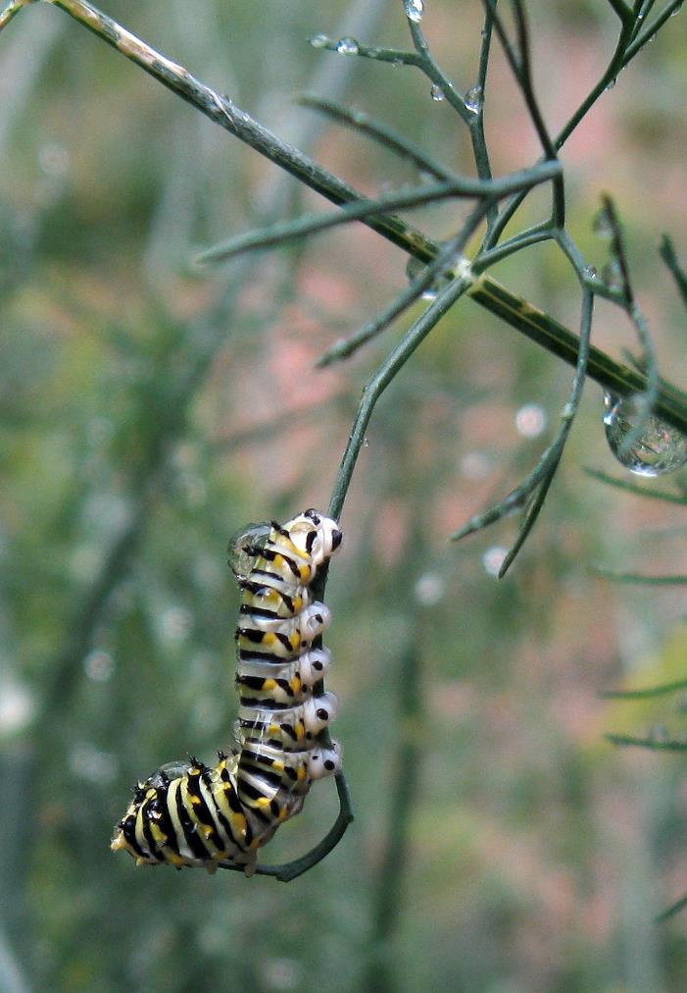
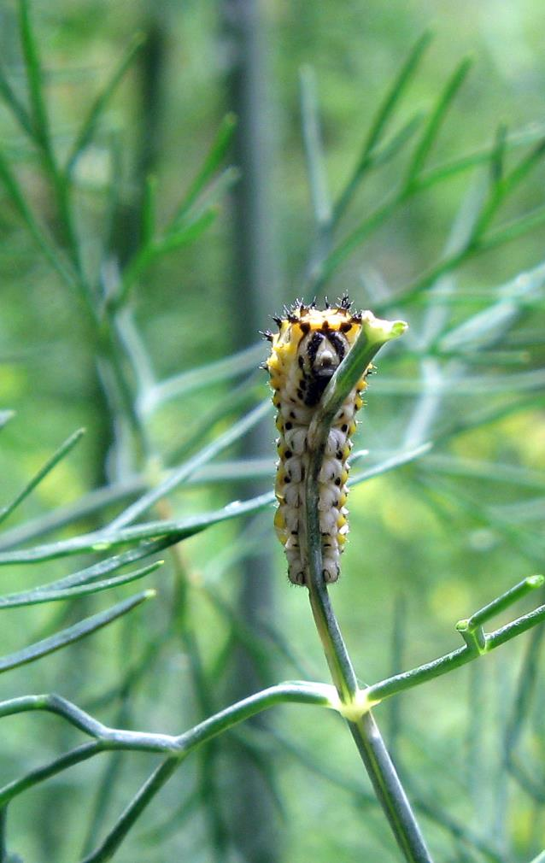

Slide 17
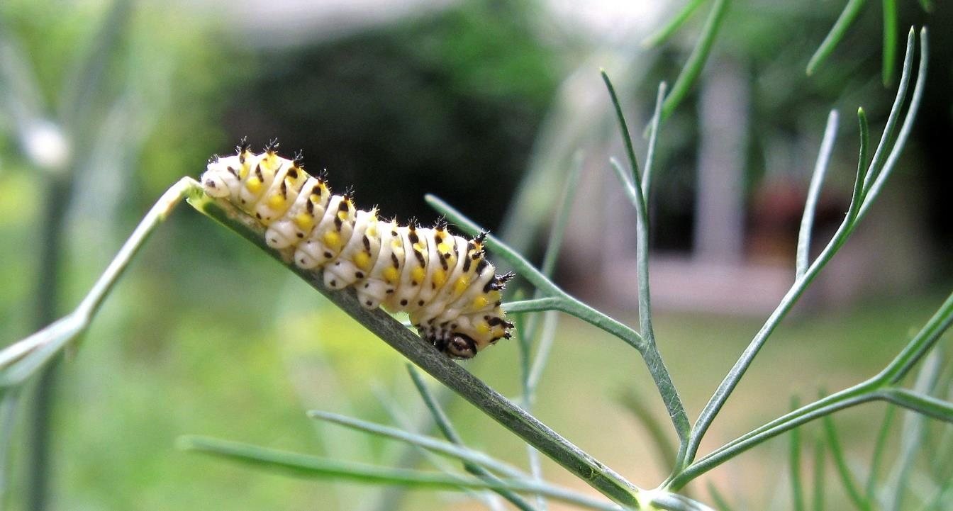

Slide 18
Fourth instar
The fourth and fifth instars have a colour palette of green, yellow, white and black. The fourth instar is the last to have chalazae. These two instars really pack on the weight.

Slide 19
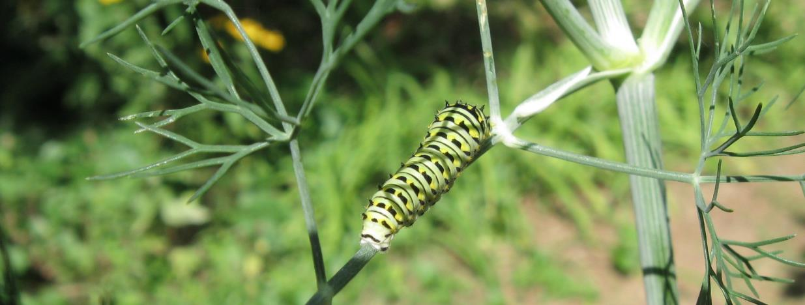
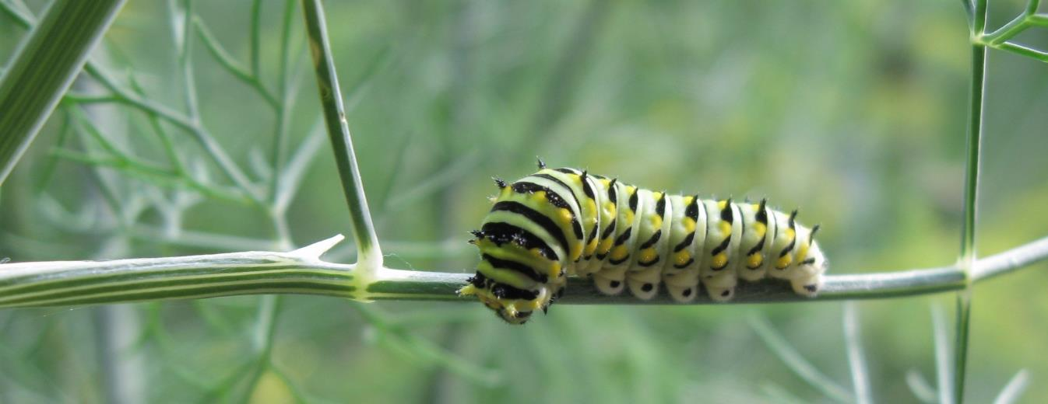

Slide 20
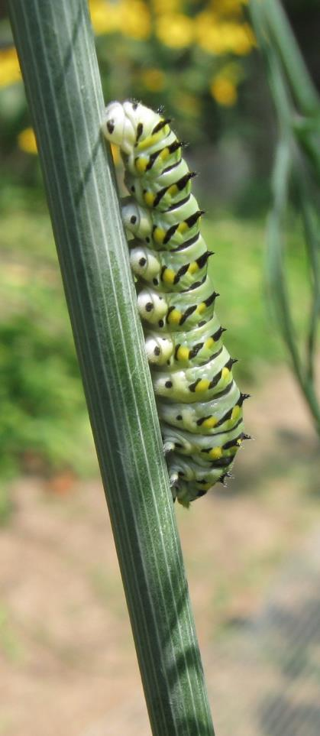
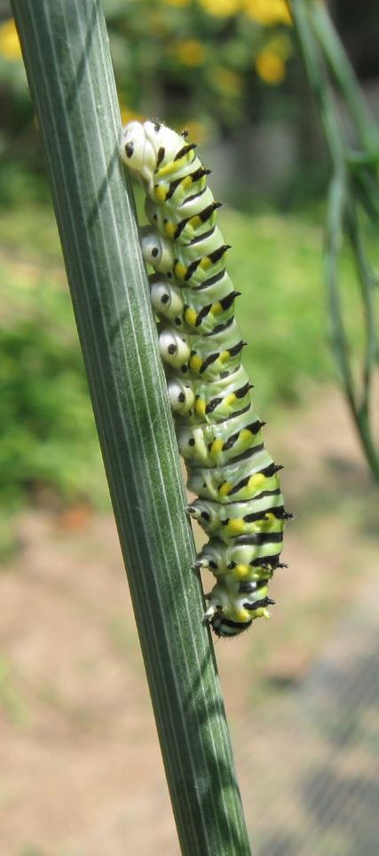
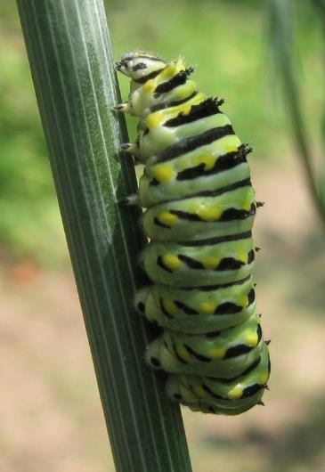
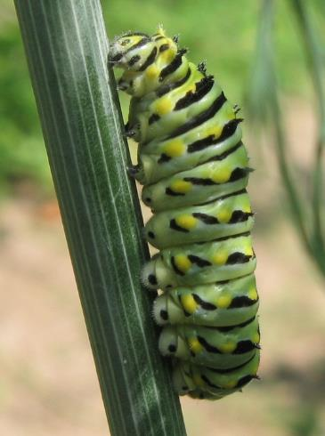
Stretching exercises can burn calories away.

Slide 21
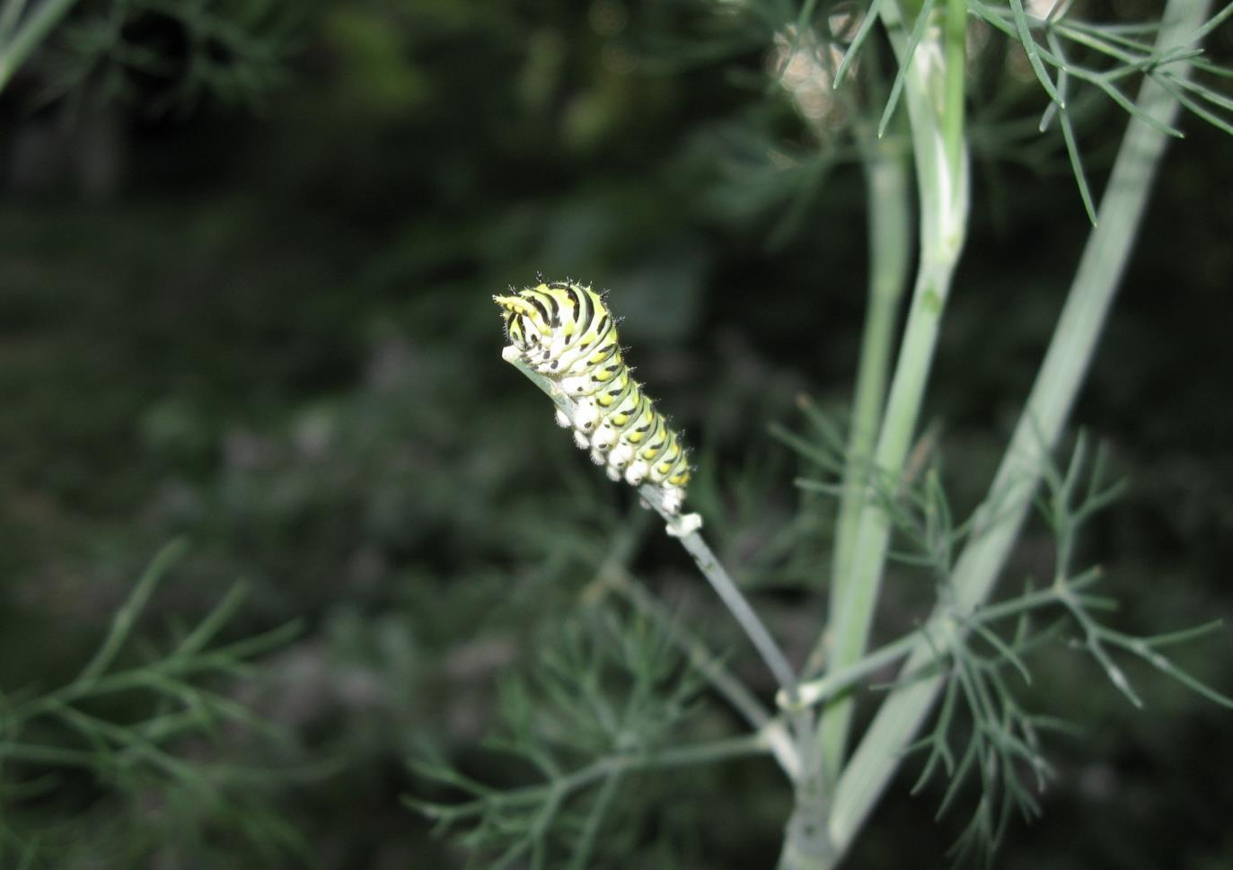
So much eating, so little time!

Slide 22
Fifth instar

Slide 23
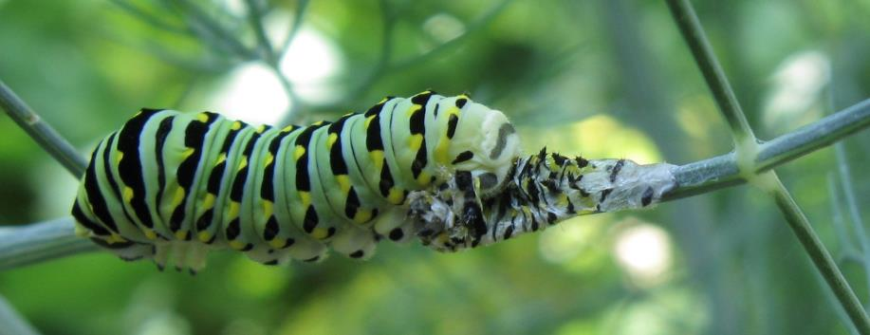
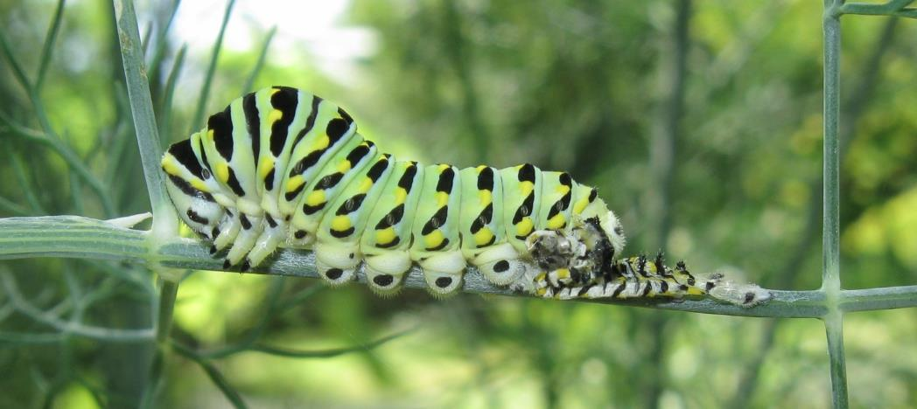
Crawling out of its skin. The old exoskeleton is attached with silk at the back end and then the caterpillar creeps forward out of its skin.
While the new skin is soft, the caterpillar creates room to grow by swallowing air to puff itself up.
Each segment has a spiracle for breathing.

Slide 24
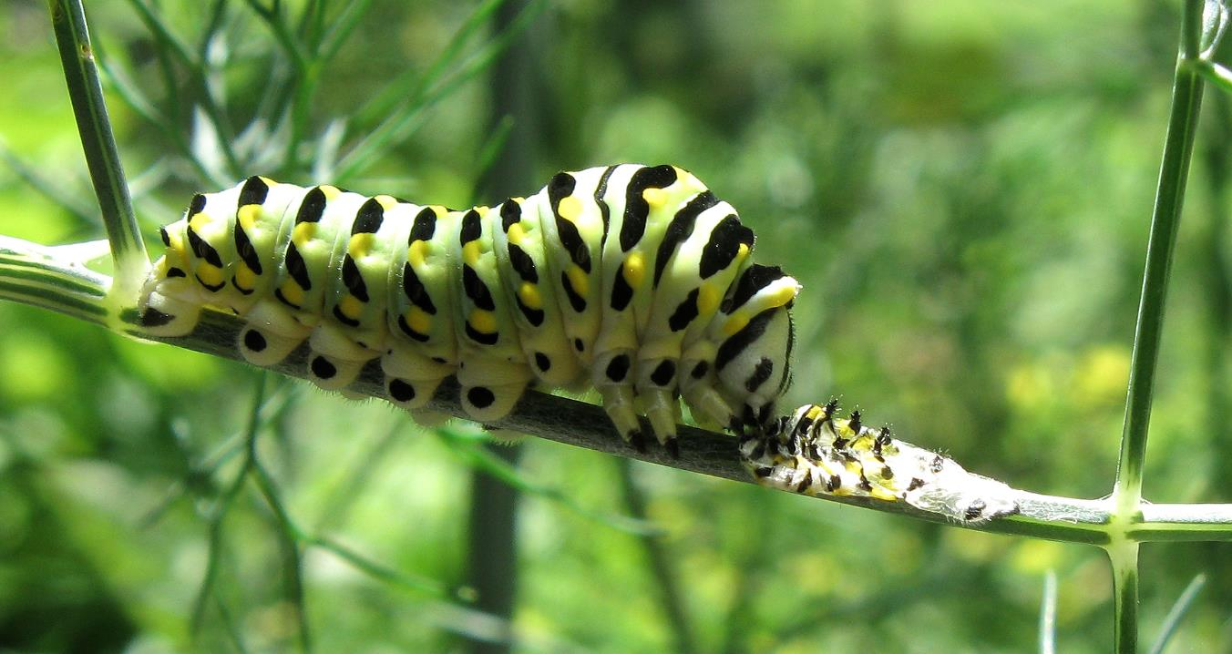
Waste not, want not. Time to gobble up that yummy exoskeleton!

Slide 25
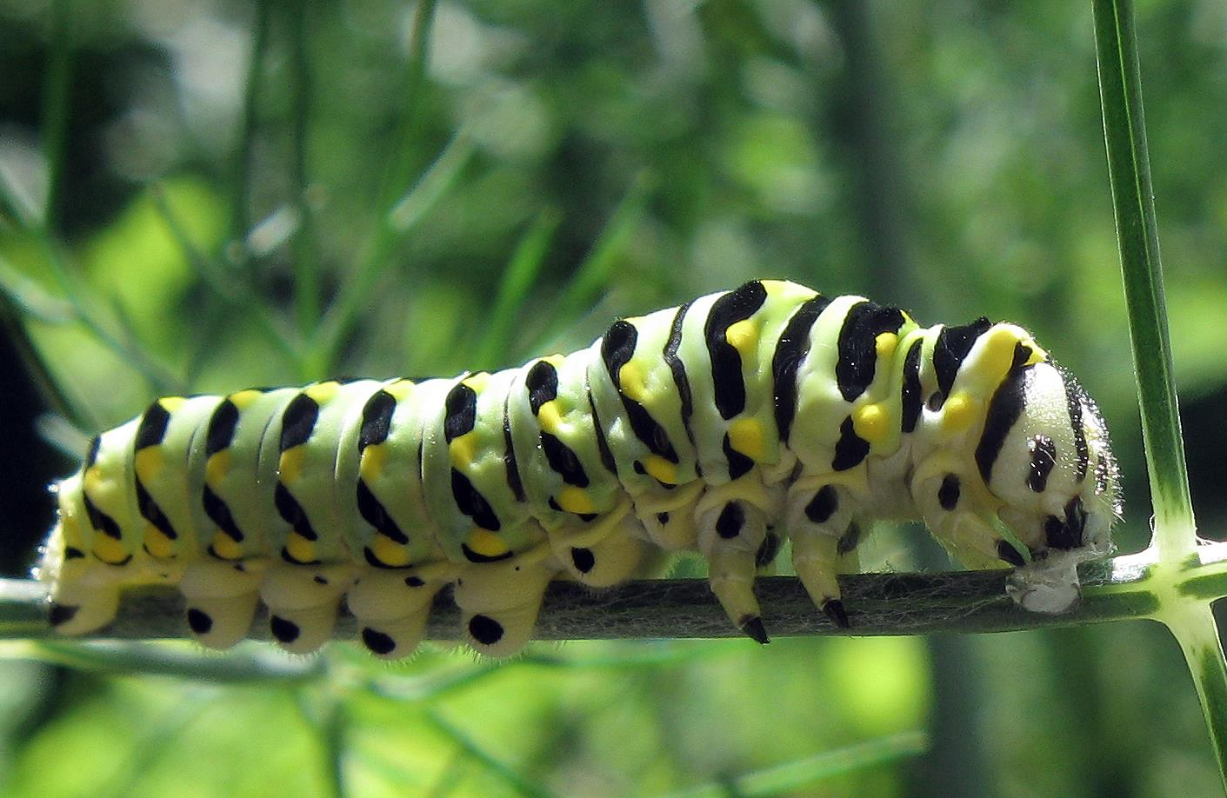

Slide 26
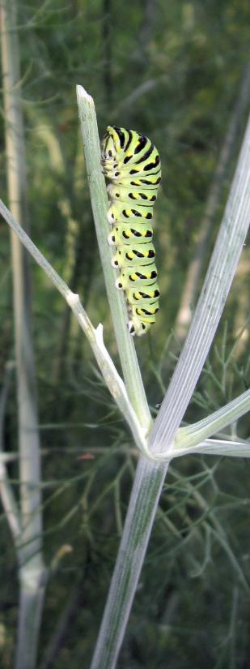
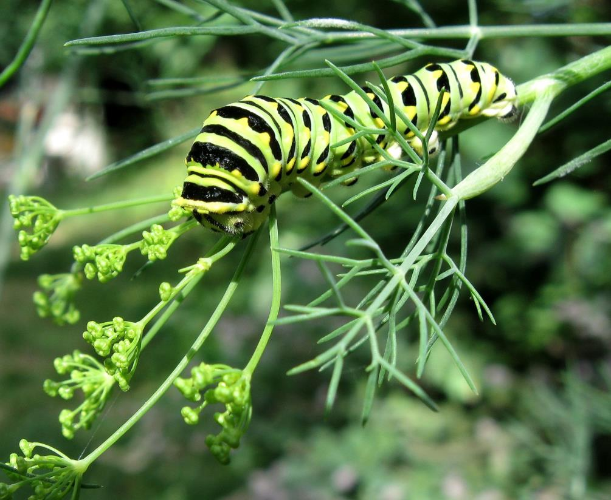
This instar is all about eating, taking on flowers and bigger stems.

Slide 27
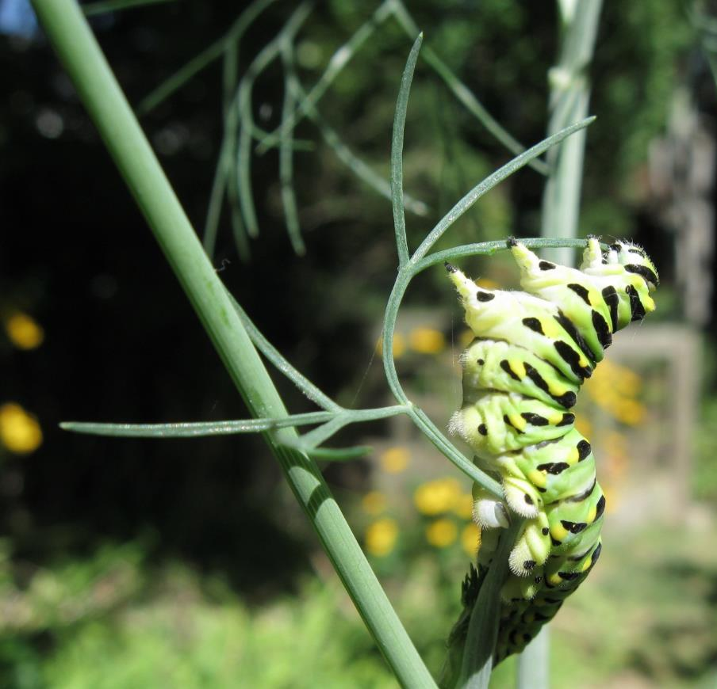
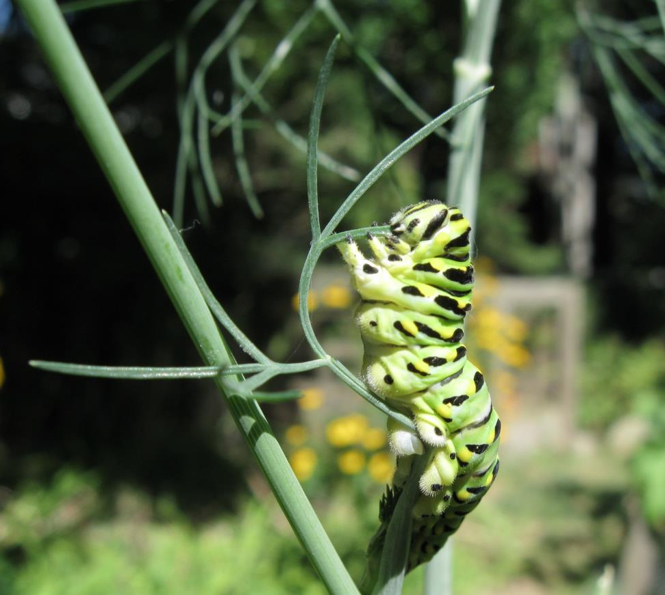
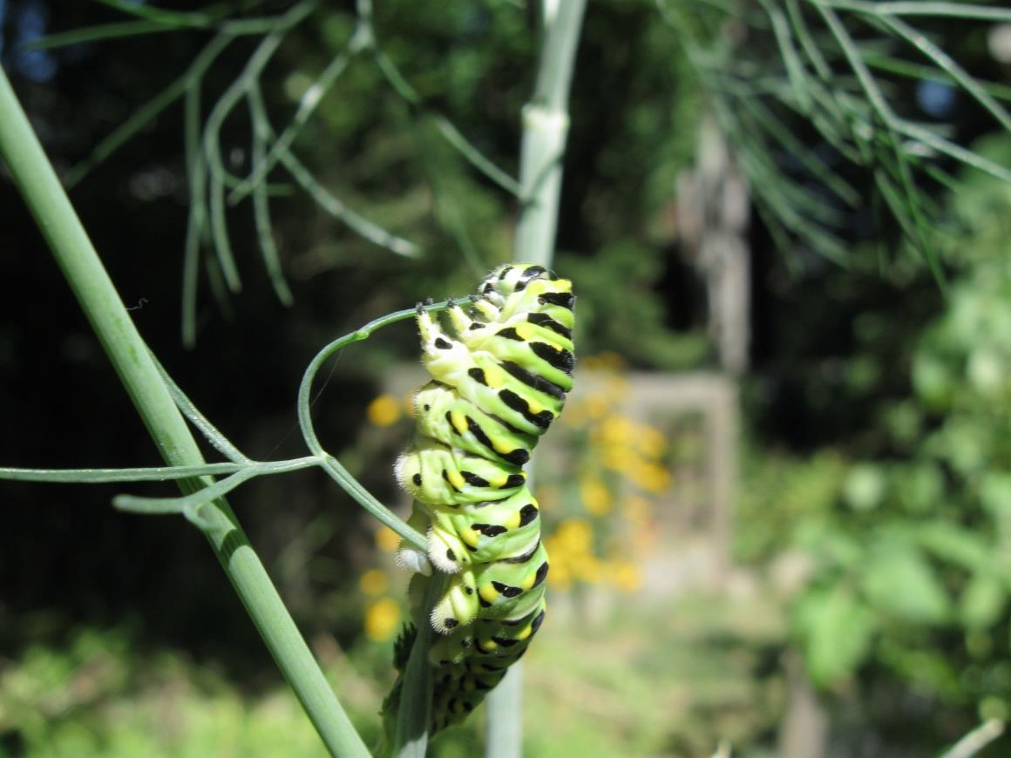

Slide 28
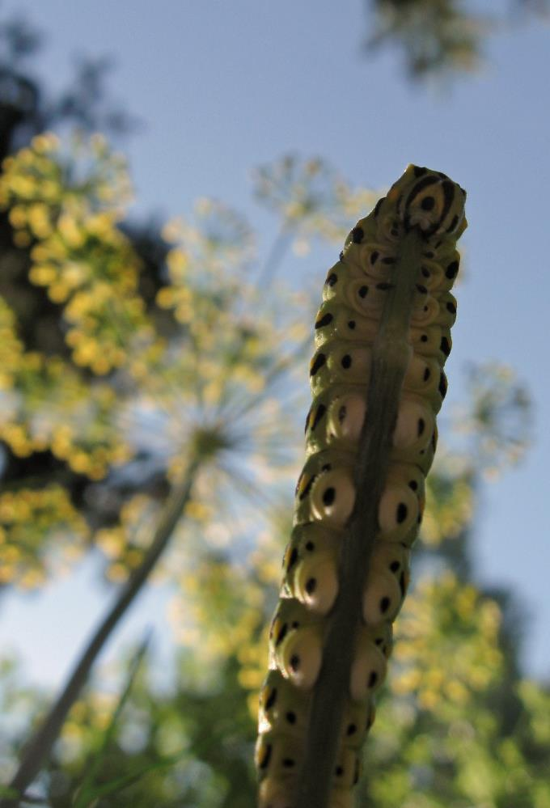
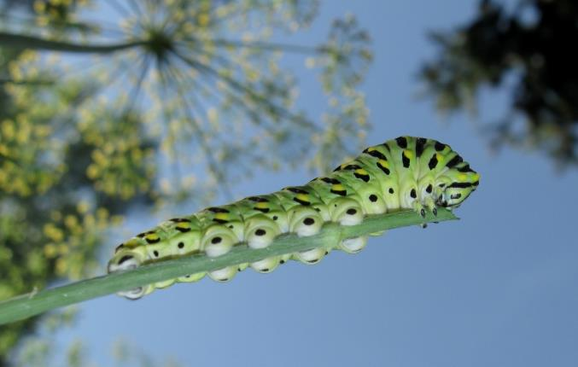
A different perspective.

Slide 29
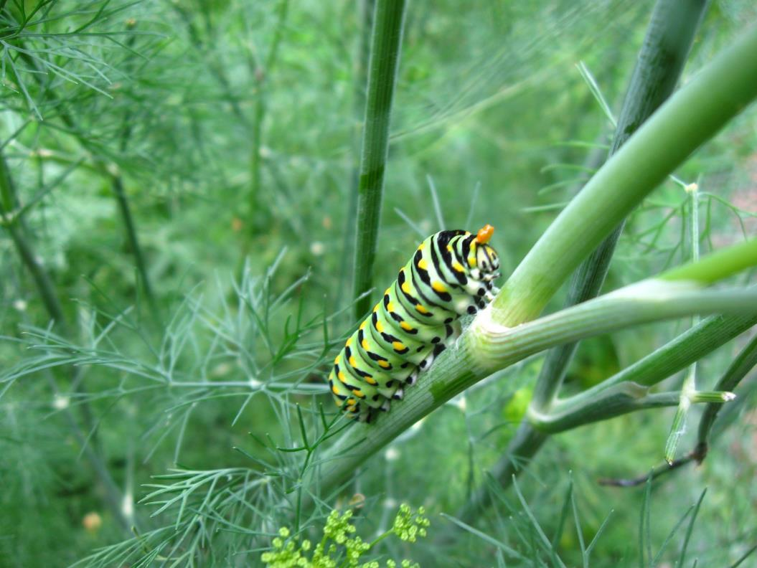
Time for a little defence. The orange horn is called an osmeterium. The caterpillar protrudes it and it emits a foul-smelling odour to dissuade predators. Waving it about increases the effective range.

Slide 30
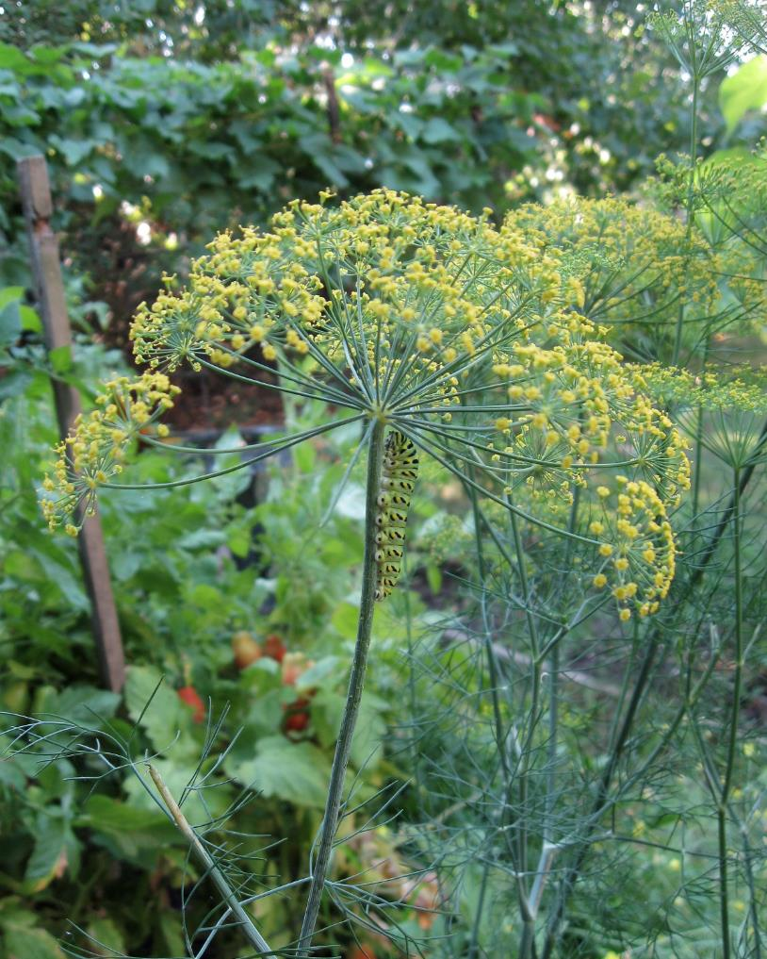
The dill is in bloom!
What to do?

Slide 31
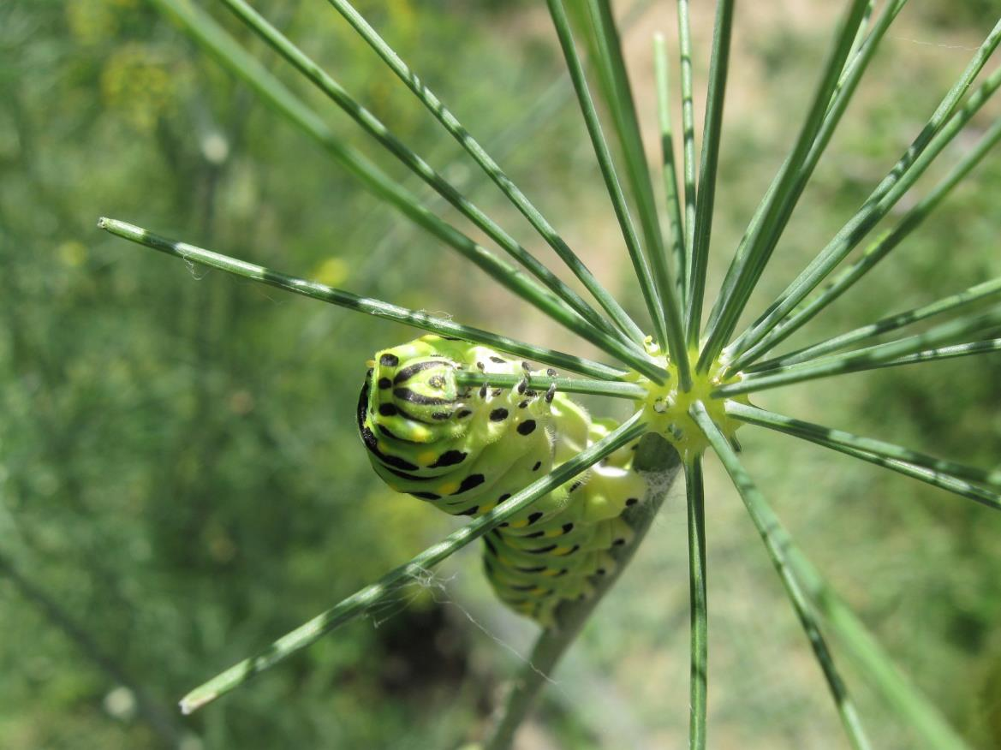
Good to the last stem!

Slide 32
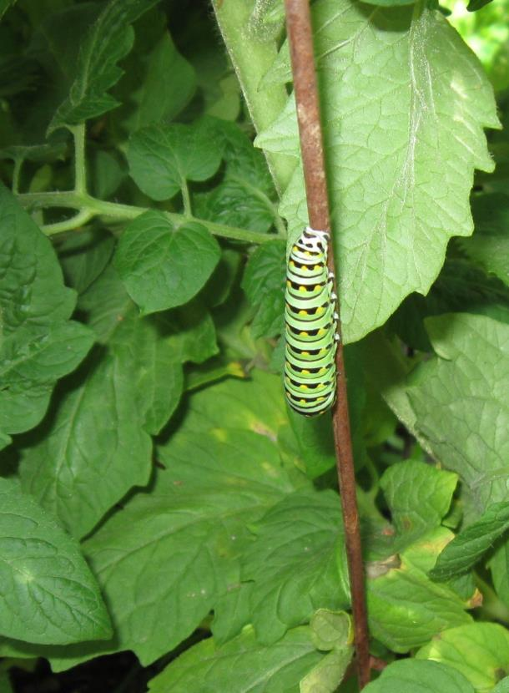
Comma
Time to move on. Off the dill to the tomato plant next door. Surprisingly, the tomato cage is favoured.

Slide 33
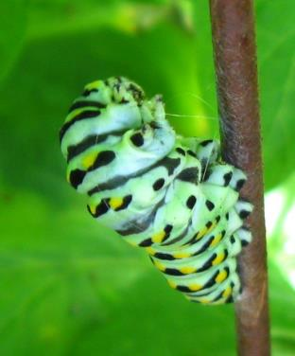
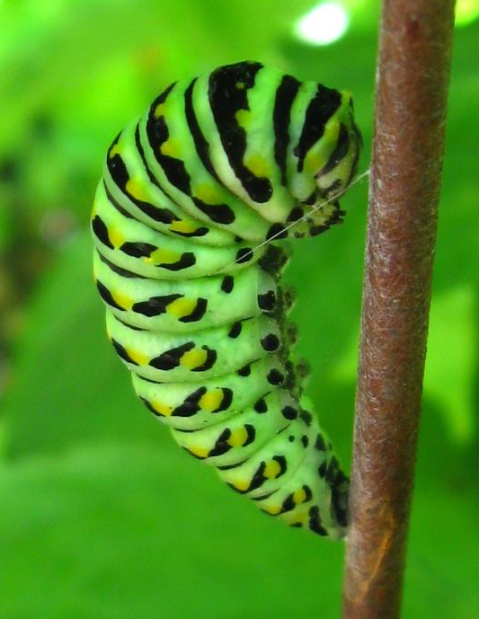
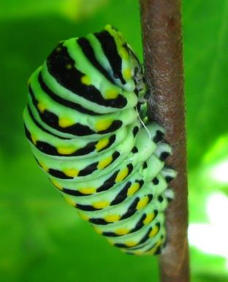
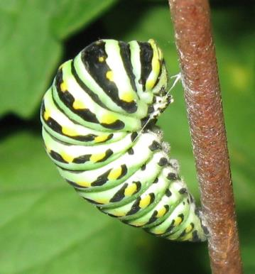
Spinning a harness

Slide 34
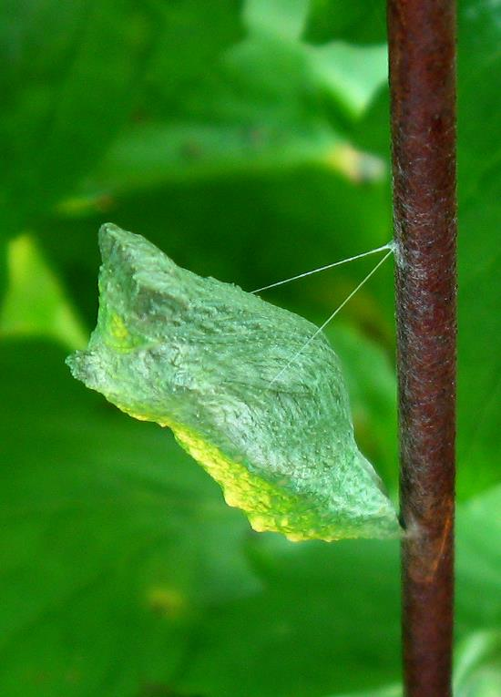
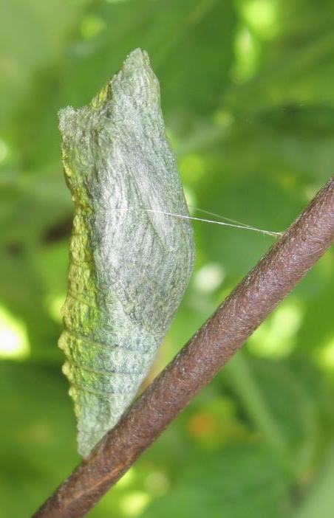
36 to 48 hours later – a chrysalis

Slide 35
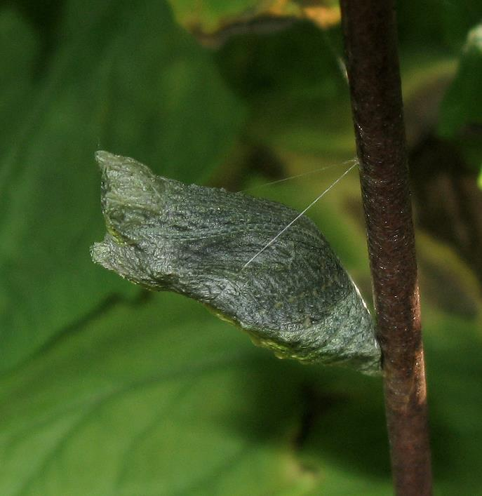
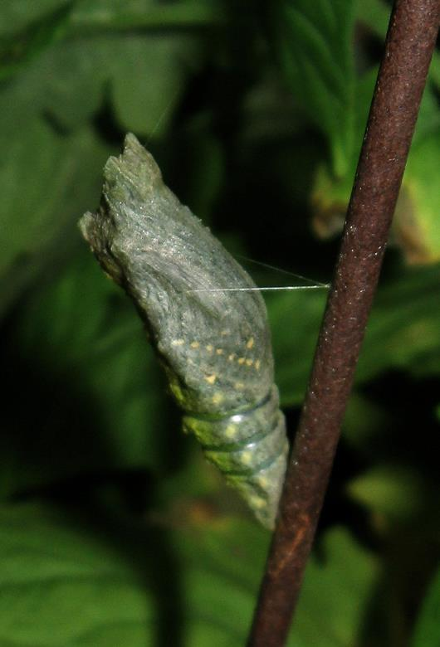
As time goes by …

Slide 36
Emergence

Slide 38
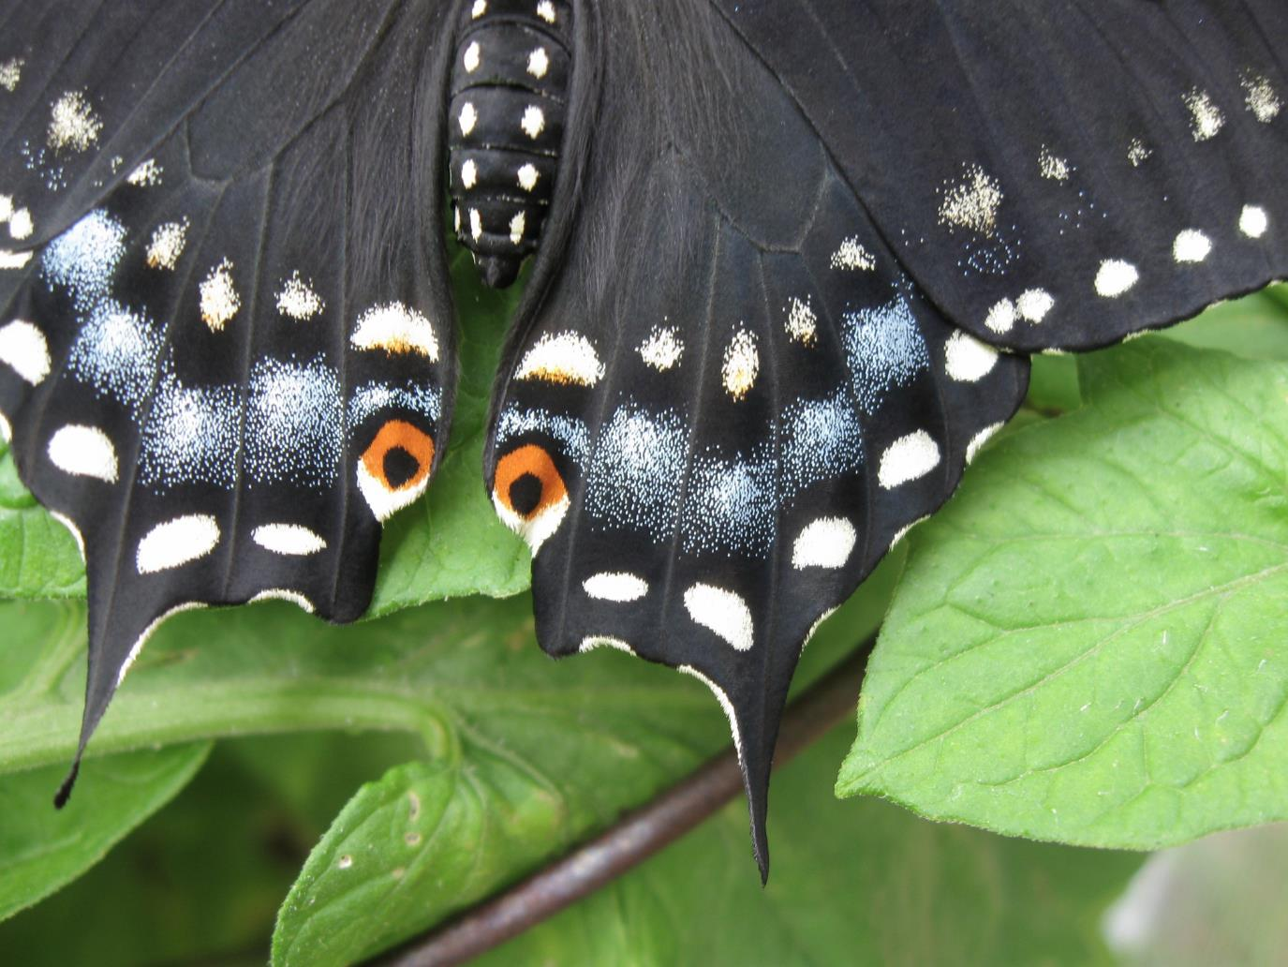

Slide 41
I’ve always wanted one of these!
The end.

